Slide 1
CSE 3400/CSE 5850 - Introduction to Cryptography and Cybersecurity / Introduction to Cybersecurity Lecture 11 Public Key Cryptography– Part II
Ghada Almashaqbeh
UConn
*Adapted from the textbook slides

Slide 2
Outline
Public key encryption.
Digital signatures.
2

Slide 3
Public Key Encryption
3

Slide 4
Public Key Encryption
Key length l
KeyGen KG
Encryption Key e
(public)
(e,d)
Decryption Key d
(private)
e
d
Plaintext
m
Encrypt E
Ciphertext c=E_{e}(m)
Decrypt D
Plaintext m=D_{d}(E_{e}(m))
4

Slide 5
Public Key Encryption IND-CPA Security
Same security game as before.
The attacker chooses two messages of the same length, and is challenged to correctly guess which of these messages was encrypted by the challenger.
The difference is that the attacker does not need an oracle access to the encryption oracle!
The public encryption key is known to everyone, including the adversary, and can use it to encrypt any message they want.
Can a deterministic public key encryption scheme be an IND-CPA secure?
5

Slide 6
Discrete Log-based Encryption
We will study two constructions:
An adaptation of DH key exchange protocol to perform encryption.
ElGamal encryption scheme.

Slide 7
The DH Encryption Scheme
Encryption:
Decryption:

Slide 8
The DH Encryption Scheme---Correctness and Security
May not be secure!
Believed to be secure under the CDH assumption, however, it is not always true! g^{ab} may leak some information (or bits) as we studied before.
Solution?
The hashed DH encryption scheme.

Slide 9
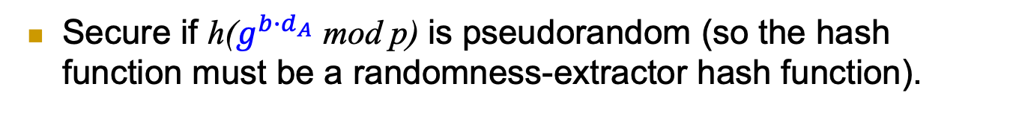
The Hashed DH Encryption Scheme
Secure if h($g^{{b∙d}_{A}}$ mod p) is pseudorandom (so the hash function must be a randomness-extractor hash function).

Slide 10


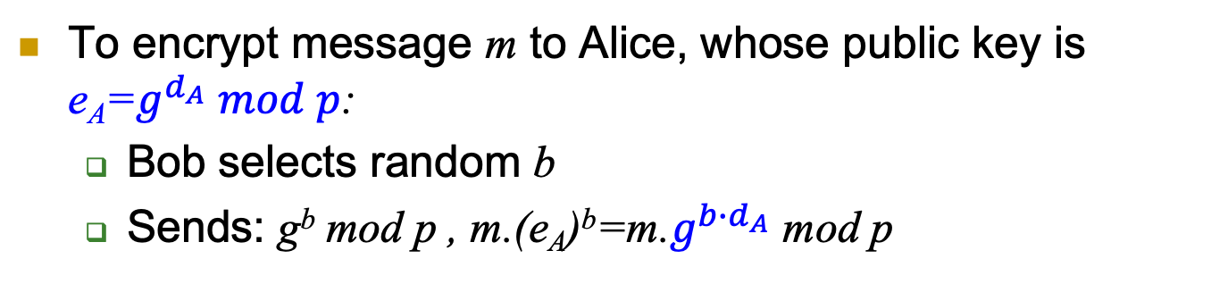
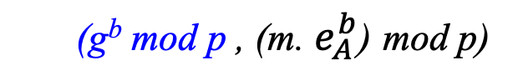
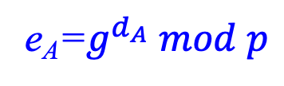
ElGamal Public Key Encryption
To encrypt message m to Alice, whose public key is e_{A}=$g^{d_{A}} mod p$:
Bob selects random b
Sends: g^{b} mod p , m.(e_{A})^{b}=m.$g^{{b∙d}_{A}}$ mod p
Alice
e_{A}=$g^{d_{A}} mod p$
Bob
Select
random b
(g^{b} mod p , (m. $e_{A}^{b}$) mod p)

Slide 11
ElGamal Public Key Encryption
Encryption:
Decryption:
Correctness:

Slide 12
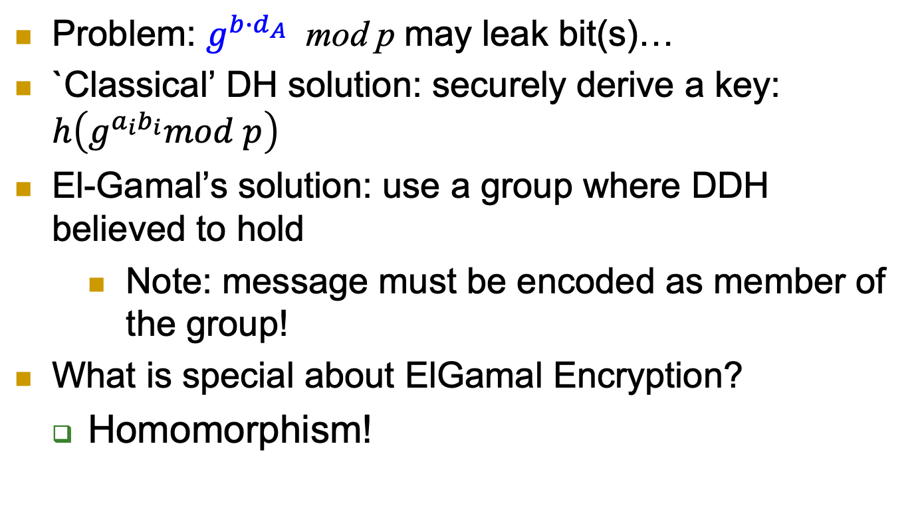
ElGamal Public Key Cryptosystem
Problem: $g^{{b∙d}_{A}}$ mod p may leak bit(s)…
`Classical’ DH solution: securely derive a key: $h\left(g^{a_{i}b_{i}}mod p\right)$
El-Gamal’s solution: use a group where DDH believed to hold
Note: message must be encoded as member of the group!
What is special about ElGamal Encryption?
Homomorphism!

Slide 13
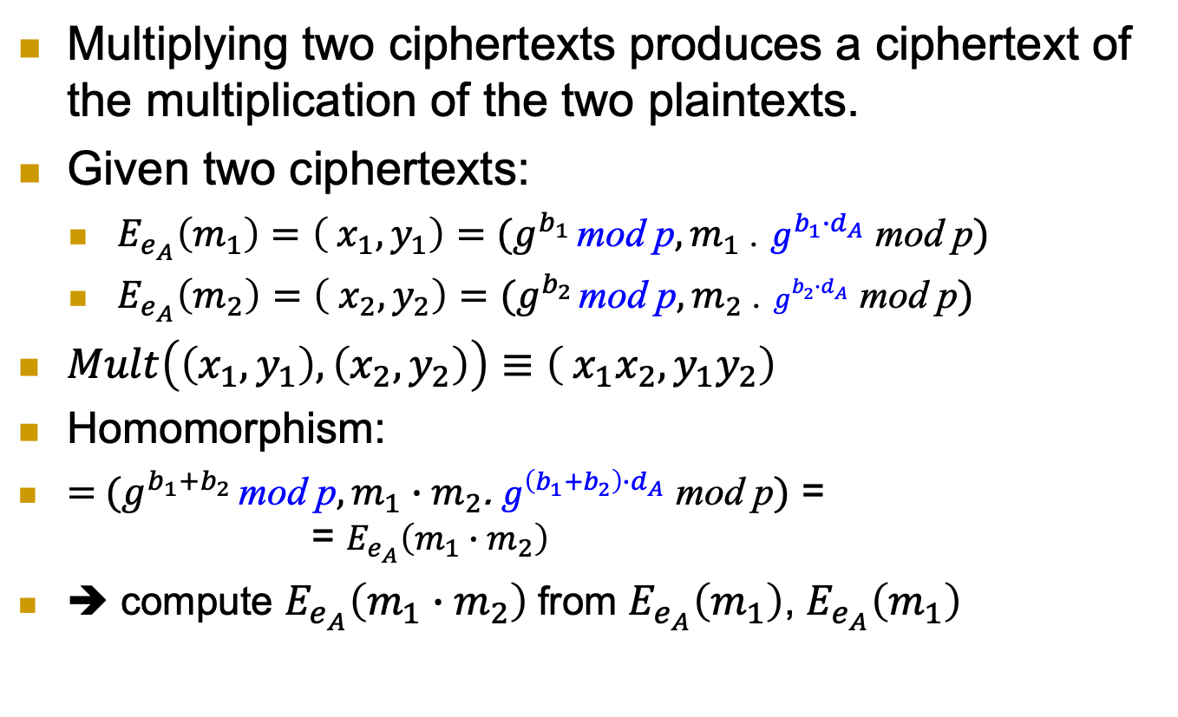
ElGamal PKC: homomorphism
Multiplying two ciphertexts produces a ciphertext of the multiplication of the two plaintexts.
Given two ciphertexts:
$E_{e_{A}}\left(m_{1}\right)=\left( x_{1},y_{1}\right)=(g^{b_{1}} \text{mod} \text{p},m_{1}\text{ .} g^{{b_{1}∙d}_{A}} \text{mod} \text{p})$
$E_{e_{A}}\left(m_{2}\right)=\left( x_{2},y_{2}\right)$ $=(g^{b_{2}} \text{mod} \text{p},m_{2} \text{.} g^{{b_{2}∙d}_{A}} \text{mod} \text{p})$
$Mult\left(\left(x_{1},y_{1}\right),\left(x_{2},y_{2}\right)\right)≡\left( x_{1}x_{2},y_{1}y_{2}\right)$
Homomorphism:
$=$ $(g^{b_{1}+b_{2}} \text{mod} \text{p},m_{1}∙m_{2}\text{.} g^{{\left(b_{1}+b_{2}\right)∙d}_{A}} \text{mod} \text{p})$ = = $E_{e_{A}}\left(m_{1}∙m_{2}\right)$
➔ compute $E_{e_{A}}\left(m_{1}∙m_{2}\right)$from $E_{e_{A}}\left(m_{1}\right)$, $E_{e_{A}}\left(m_{1}\right)$

Slide 14
RSA Public Key Encryption
First proposed – and still widely used
Select two large primes p,q ; let n=pq
Select prime e (public key: <n,e>)
Or co-prime with Φ(n) =(p-1)(q-1)
Let private key be d=e⁻¹ mod Φ(n) (i.e., ed=1 mod Φ(n))
Encryption: RSA.E_{e,n}(m)=m^{e} mod n
Decryption: RSA.D_{d,n}(c)=c^{d} mod n
Correctness: D_{d,n}(E_{e,n}(m))= (m^{e})^{d} = m^{ed} = m mod n
Intuitively: ed=1 mod Φ(n) ➔ m^{ed} = m mod n
But why? Remember Euler’s theorem.

Slide 15
RSA Public Key Cryptosystem
Correctness: D_{d,n}(E_{e,n}(m))= m^{ed} mod n
m^{ed}=m^{ed}= m^{1+l Φ(n)} =m m^{l Φ(n)} =m (m^{Φ(n)} )^{l}
m^{ed} mod n =m (m^{Φ(n)} mod n )^{l} mod n
Euler’s Theorem: m^{Φ(n)} mod n=1 mod n
➔ D_{d,n}(E_{e,n}(m))= m^{ed} mod n=m 1^{l} mod n =m
Comments:
m<n ➔ m= m mod n
Euler’s Theorem holds (only) if m, n are co-primes
If not co-primes? Use Chinese Reminder Theorem
A nice, not very complex argument
But: beyond our scope – take Crypto!
Number of messages co-prime to n ?!

Slide 16
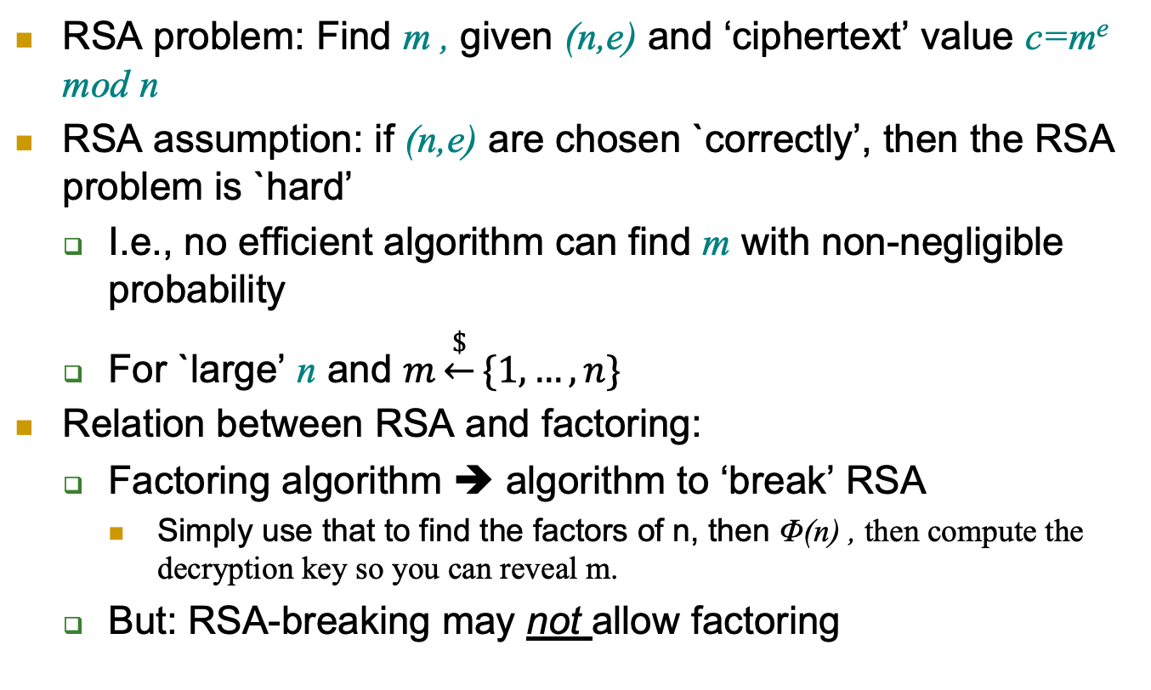
The RSA Problem and Assumption
RSA problem: Find m , given (n,e) and ‘ciphertext’ value c=m^{e} mod n
RSA assumption: if (n,e) are chosen `correctly’, then the RSA problem is `hard’
I.e., no efficient algorithm can find m with non-negligible probability
For `large’ n and $m\underset{←}{\$}\{1,…,n\}$
Relation between RSA and factoring:
Factoring algorithm ➔ algorithm to ‘break’ RSA
Simply use that to find the factors of n, then Φ(n) , then compute the decryption key so you can reveal m.
But: RSA-breaking may not allow factoring

Slide 17
RSA PKC Security
It is a deterministic encryption scheme → cannot be IND-CPA secure.
RSA assumption does not rule out exposure of partial information about the plaintext.
A solution: apply a random padding to the plaintext then encrypt using RSA.

Slide 18
Padded RSA
Pad and Unpad functions:
Encryption with padding:
Decryption with unpad:
So it adds randomization to Prevent detection of repeating plaintext
Padding must be done carefully; certain padding algorithms still do not guarantee CPA security.

Slide 19
Digital Signature
19

Slide 20
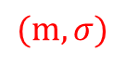
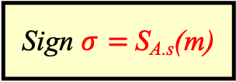
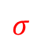
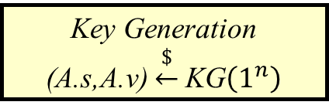
Public Key Digital Signatures
Key Generation
(A.s,A.v) $\underset{←}{\$}$KG$\left(1^{n}\right)$
Key length n
Alice’s private
signing key A.s
Alice’s public verification key A.v
A.s
A.v
Message
m
Sign $σ=$S_{A.s}(m)
$$σ$$
$$(m,σ)$$
Verify V_{A.v}(m, σ)
Sign using a private, secret signing key (A.s for Alice)
Validate using a public verification key (A.v for Alice)
Everybody can validate signatures at any time
Provides authentication, integrity and evidence / non-repudiation
MAC: ‘just’ authentication + integrity, no evidence, can repudiate

Slide 21
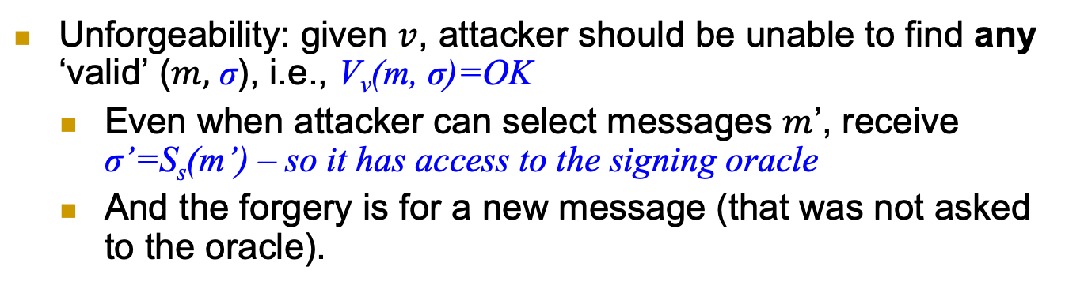
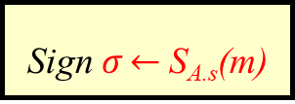
Digital Signatures Security: Unforgeability
Key Generation
(A.s,A.v) $\underset{←}{\$}$KG$\left(1^{n}\right)$
Key length n
Alice’s private
signing key A.s
Alice’s public verification key A.v
A.s
A.v
Message
m
Sign $σ\underset{←}{}$S_{A.s}(m)
$$σ$$
$$(m,σ)$$
Verify V_{A.v}(m, σ)
Unforgeability: given $v$, attacker should be unable to find any ‘valid’ ($m,$ σ), i.e., V_{v}(m, σ)=OK
Even when attacker can select messages $m$’, receive σ’=S_{s}(m’) – so it has access to the signing oracle
And the forgery is for a new message (that was not asked to the oracle).

Slide 22
Digital Signature Scheme Definition
n
n
n
(s, v), the signing and verification keys, respectively.
n
n

Slide 23
Digital Signature Scheme Security

Slide 24

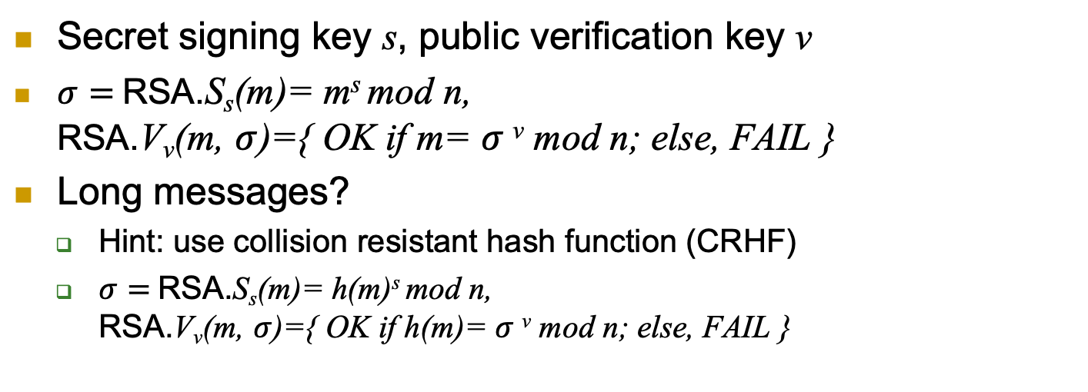
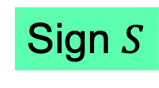
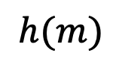
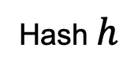

RSA Signatures
Secret signing key s, public verification key v
$σ=$RSA.S_{s}(m)= m^{s} mod n, RSA.V_{v}(m, $σ$)={ OK if m= $σ$^{v} mod n; else, FAIL }
Long messages?
Hint: use collision resistant hash function (CRHF)
$σ=$RSA.S_{s}(m)= h(m)^{s} mod n, RSA.V_{v}(m, $σ$)={ OK if h(m)= $σ$^{v} mod n; else, FAIL }
Message $m$
Hash $h$
$$h(m)$$
Sign $S$
$$S_{s}^{h}\left(m\right)$$
Notes:
24
(c) Amir Herzberg, http://AmirHerzberg.com, Bar Ilan University
04/07/06

Slide 25
Discrete-Log Digital Signature?
Can we sign based on assuming discrete log is hard?
Most well-known, popular scheme: DSA
Digital Signature Algorithm, by NSA/NIST
Details: crypto course

Slide 26
Covered Material From the Textbook
Chapter 1: Sections 1.2.4,
Chapter 6:
Section 6.4 (except 6.4.4 and 6.4.5)
Section 6.5 (except 6.5.6, 6.5.7, and 6.5.8),
Section 6.6 (except 6.6.1.1 and 6.6.1.2)

Slide 27

Thank You!

